Slide 1
AES Deep Dive a.k.a Rijndael
CS4770

Slide 2
Key Size
128, 192, or 256 bits
So popular, a lot of CPUs have AES instructions built in
I don’t think I’m going to make you do inline assembly in this class.
Might be a good project in Hardware Security? I’m going to talk this over with Adam.

Slide 3
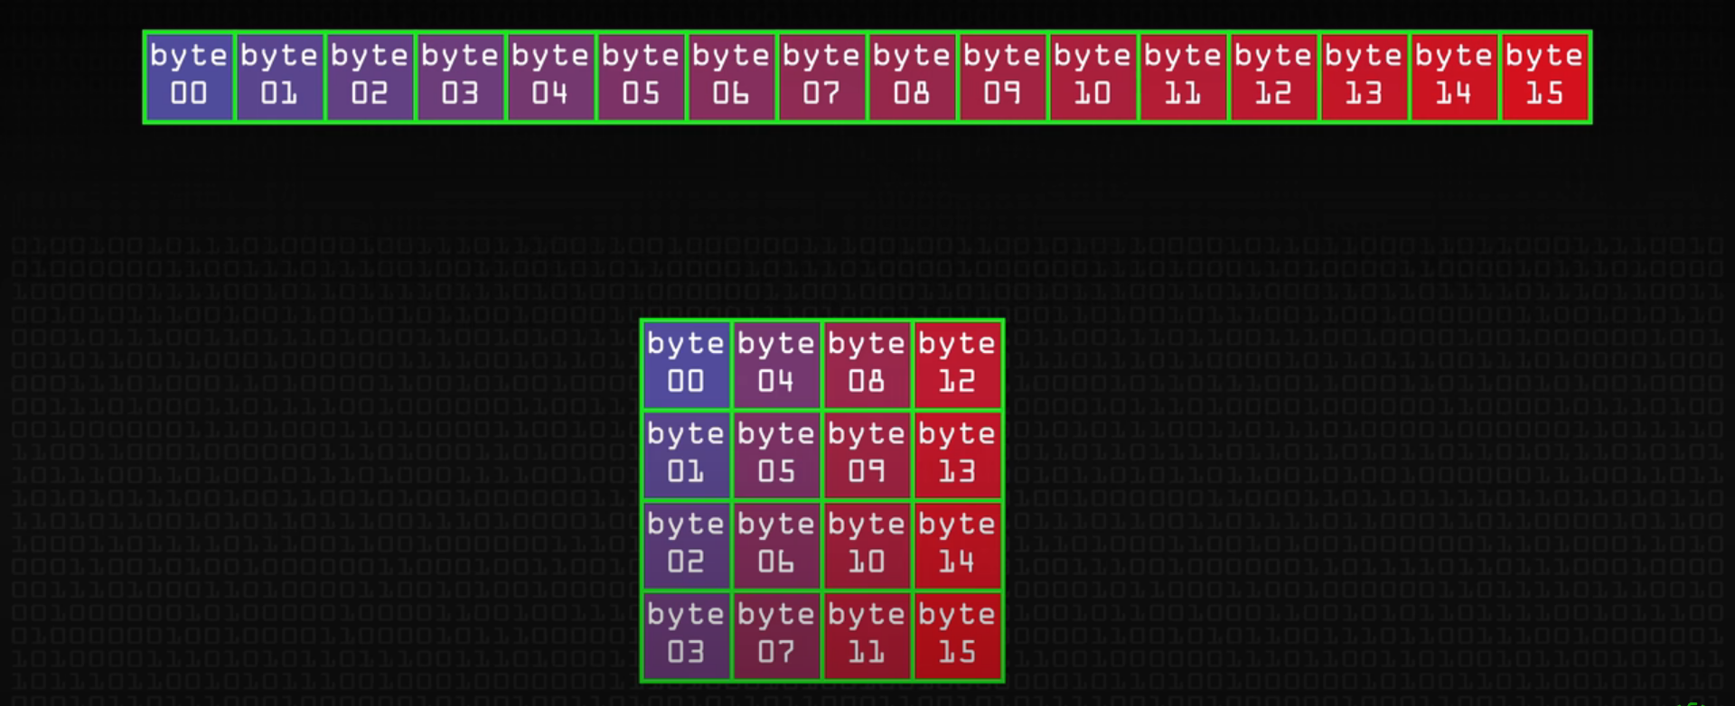
Matrix

Slide 4
Steps
Key Mixing
Still code for XOR
Substitution
Permutation
Now in 2 Dimensions!
Shifting Rows
Mix Columns (except for final round)
Multiple Round of this
10, 12, or 14 depending on key size.

Slide 5
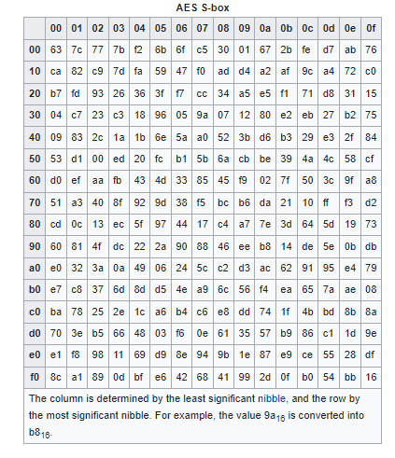
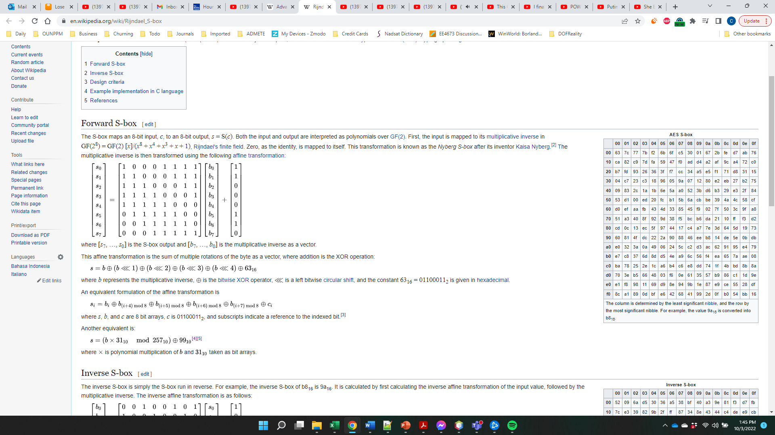
Substitution

Slide 6
Permutation
Leave Row 0 alone.
Left shift row 1 by 1 (wrapping).
Left shift row 2 by 2 (wrapping).
Left shift row 3 by 3 (or right shift by 1, wrapping).
|a₀| |2 3 1 1||b₀|
|a₁|=|1 2 3 1||b₁|
|a₂| |1 1 2 3||b₂|
|a₃| |3 1 1 2||b₃|

Slide 7
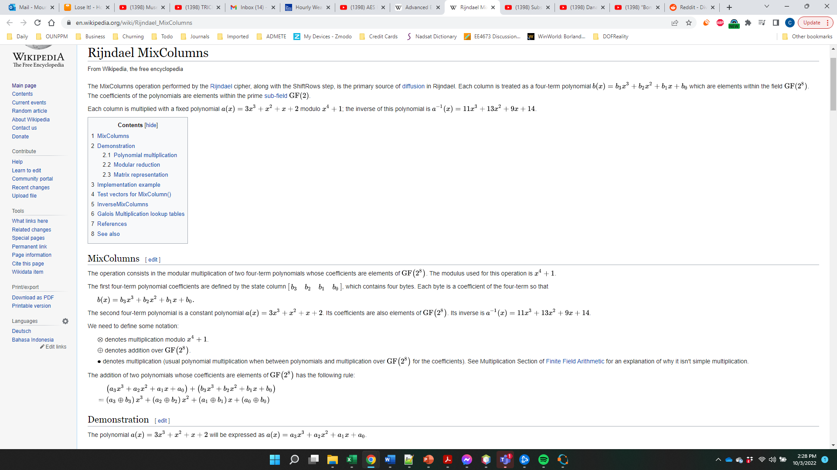
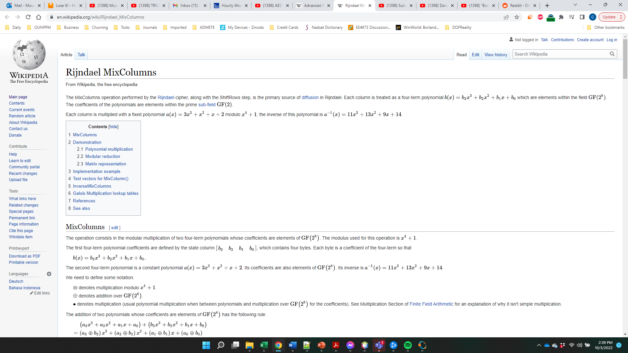
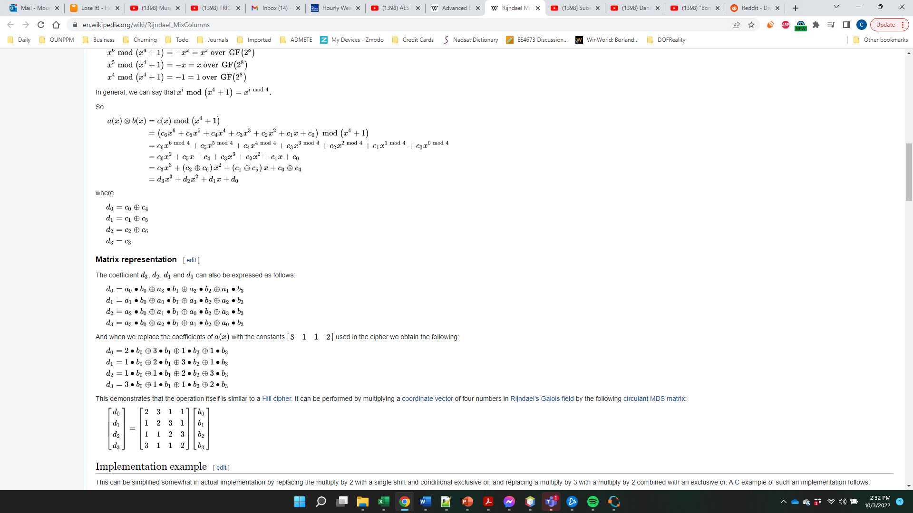
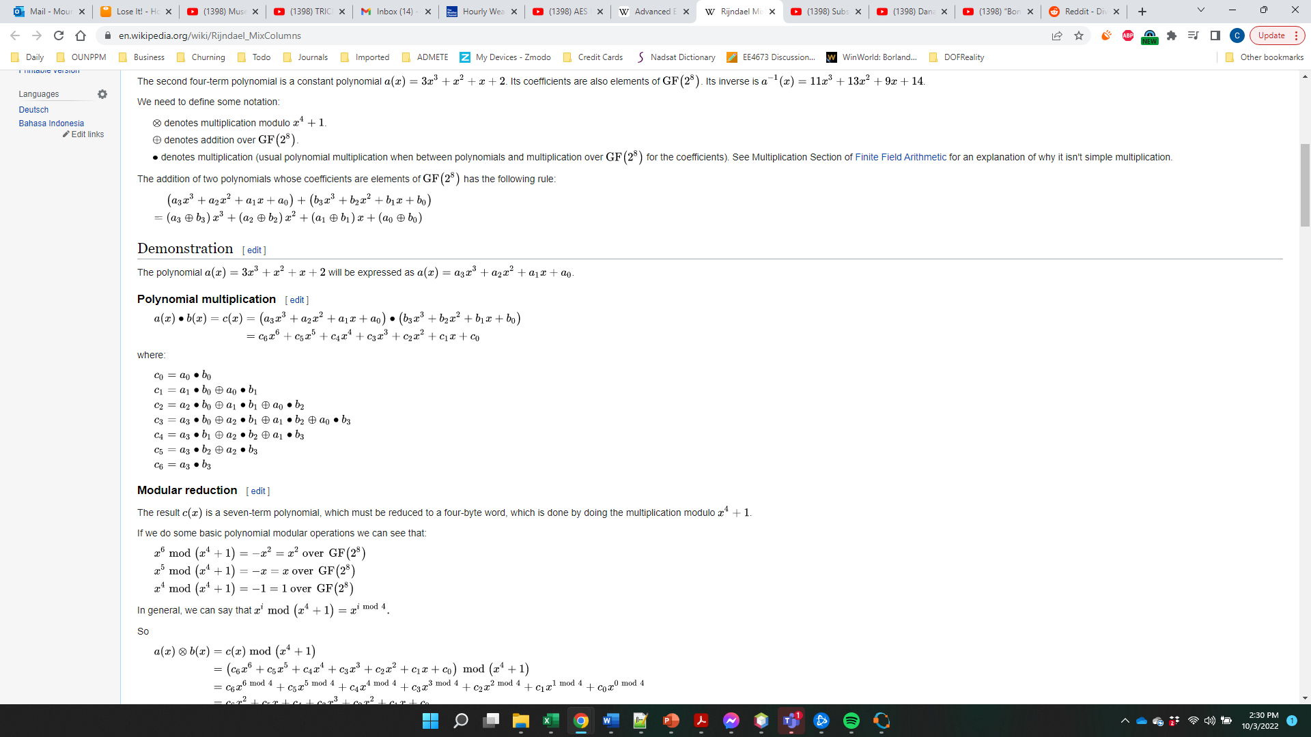
Why that matrix?
It actually represents a polynomial multiplication.
->
Yes, modular arithmetic applies to polynomials. You can multiply and divide them, so why wouldn’t it?

Slide 8
No Assignment for this one.
Maybe next year, but I think you’ve done enough crypto for now.

Slide 9
Supplemental Viewing
https://www.youtube.com/watch?v=O4xNJsjtN6E

